Slide 1
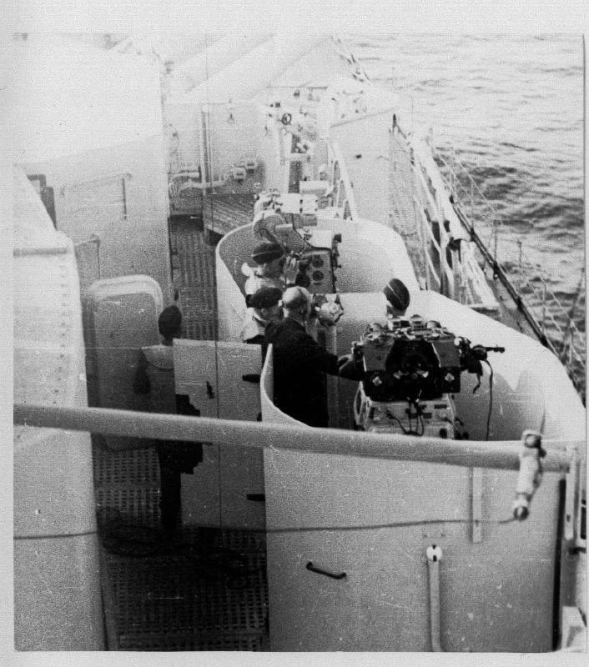
Gratuitous Picture
US Naval Artillery Rangefinder from World War I (1918)!!

Slide 2
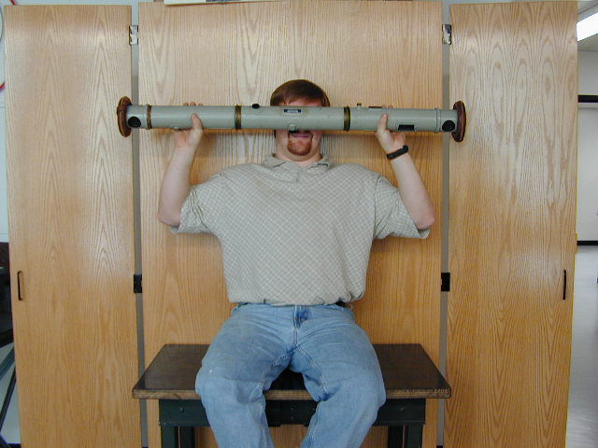
Gratuitous Picture
US Naval Artillery Rangefinder from World War I (1918)!!

Slide 3
Lecture 10: Depth

Slide 4

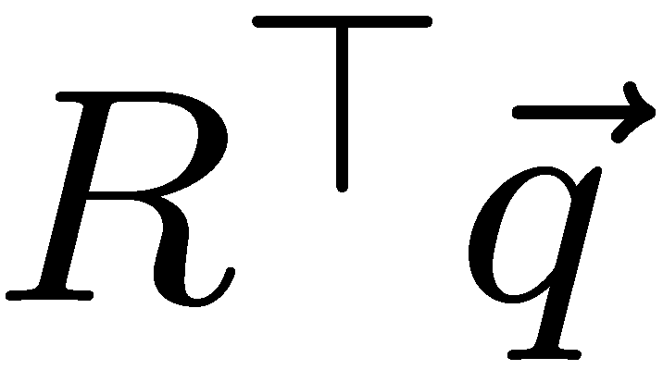

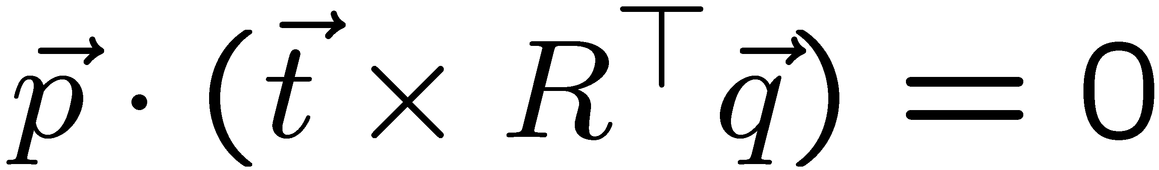
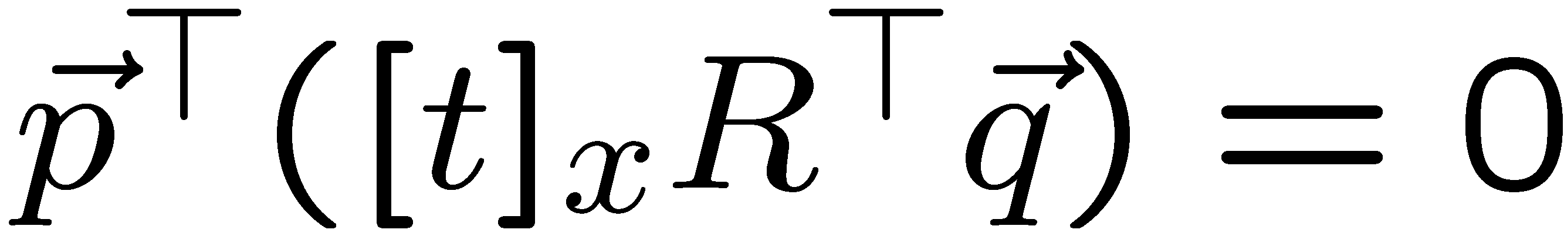
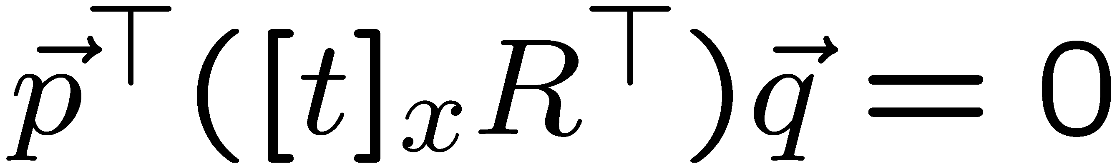
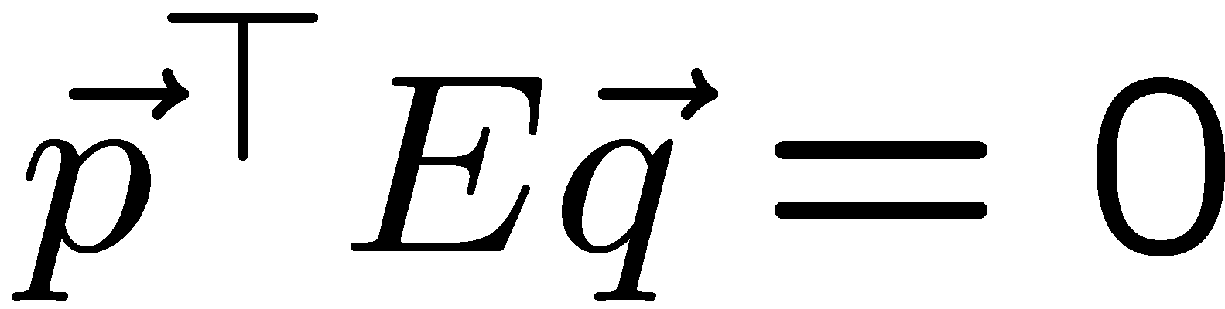
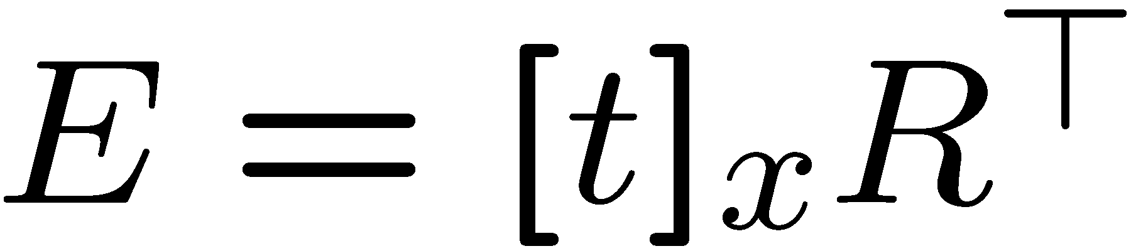
y
x
y
x
All three vectors in the same plane:

Slide 5
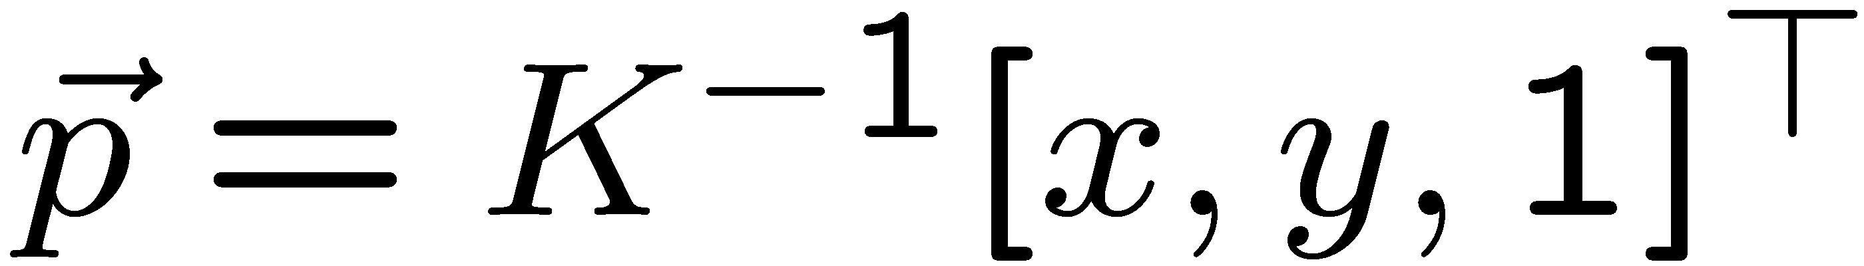
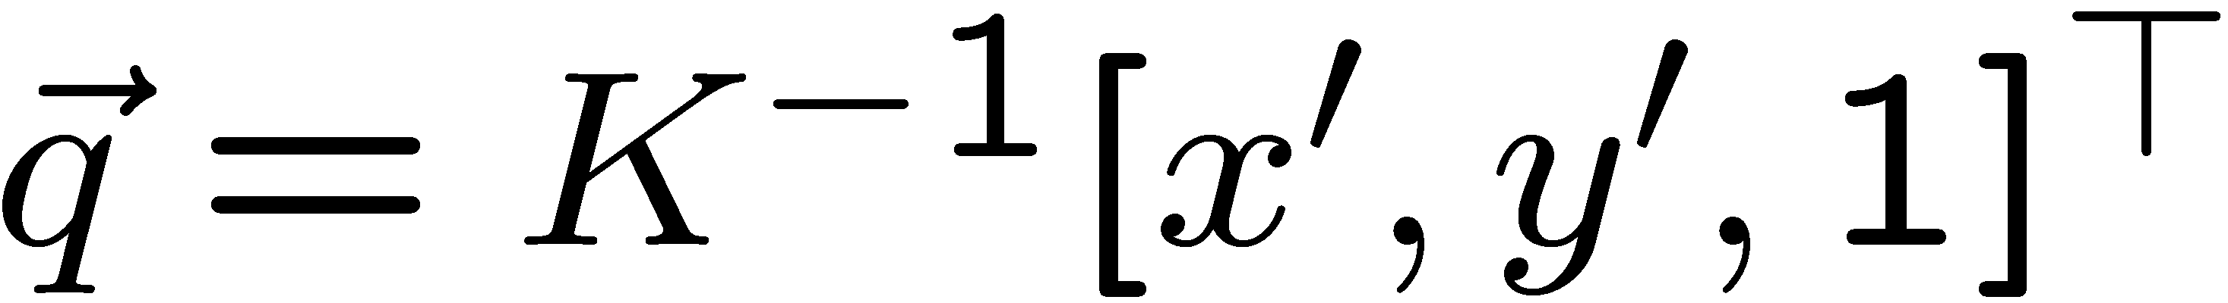
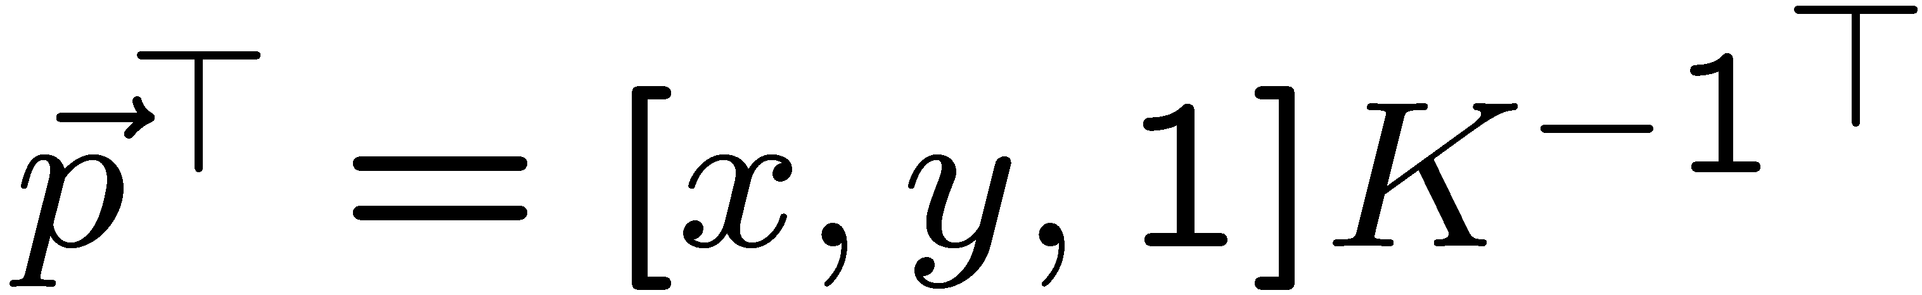
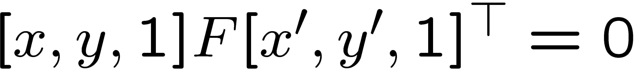
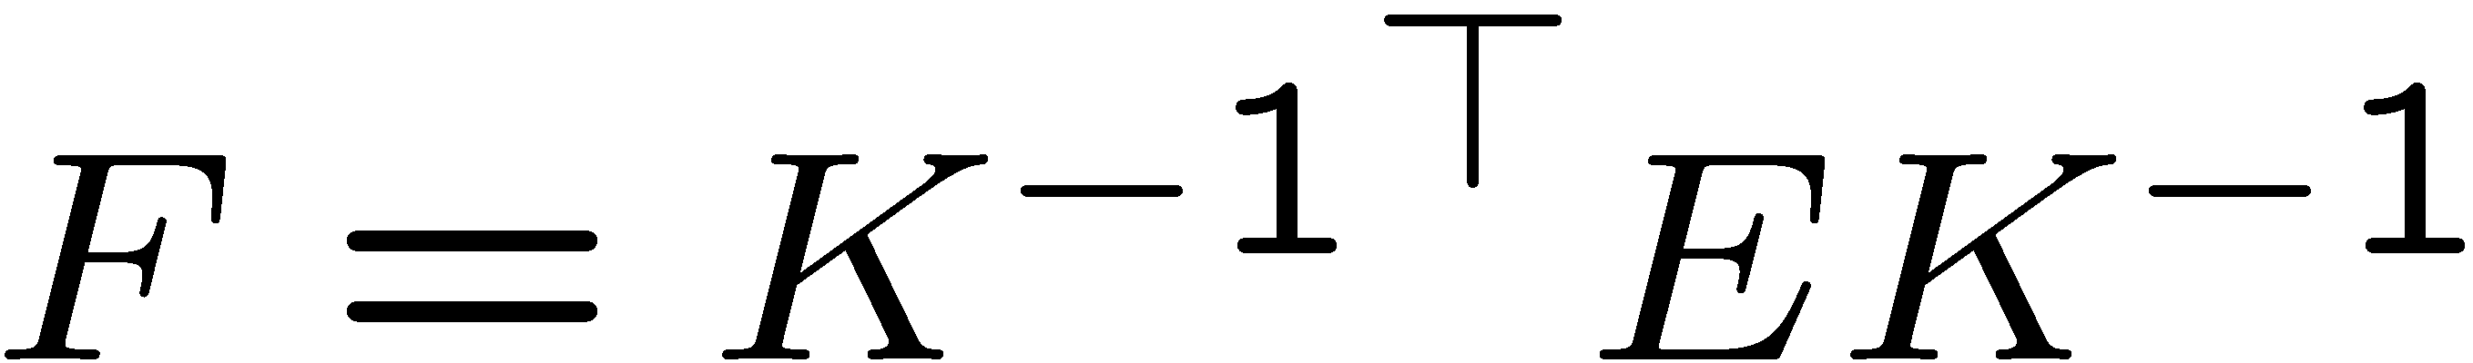
Normalized camera system, epipolar equation.
“Uncalibrated” Case, epipolar equation:
F is the “fundamental matrix”.

Slide 6
Stereo image rectification
Reproject image planes onto a common plane parallel to the line between camera centers
Pixel motion is horizontal after this transformation
Two homographies (3x3 transform), one for each input image reprojection
C. Loop and Z. Zhang. Computing Rectifying Homographies for Stereo Vision. IEEE Conf. Computer Vision and Pattern Recognition, 1999.

Slide 7
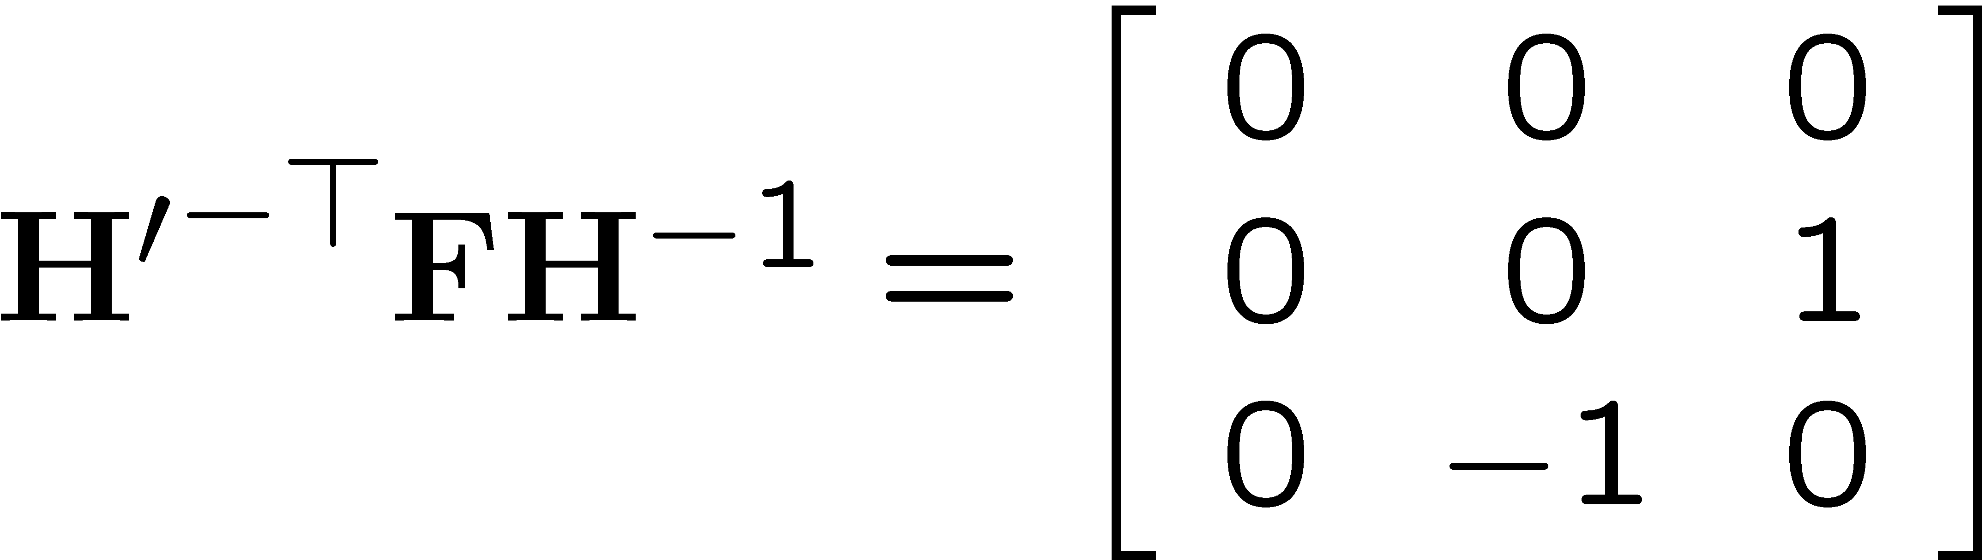
Planar rectification
Bring two views
to standard stereo setup
(moves epipole (on image) to ∞)

Slide 8
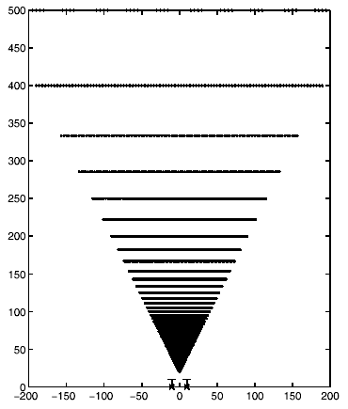
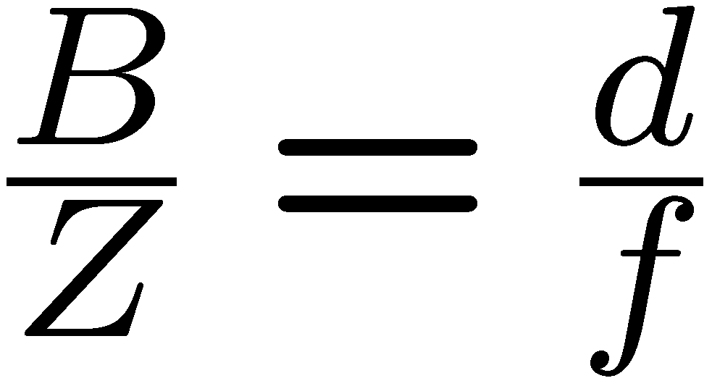

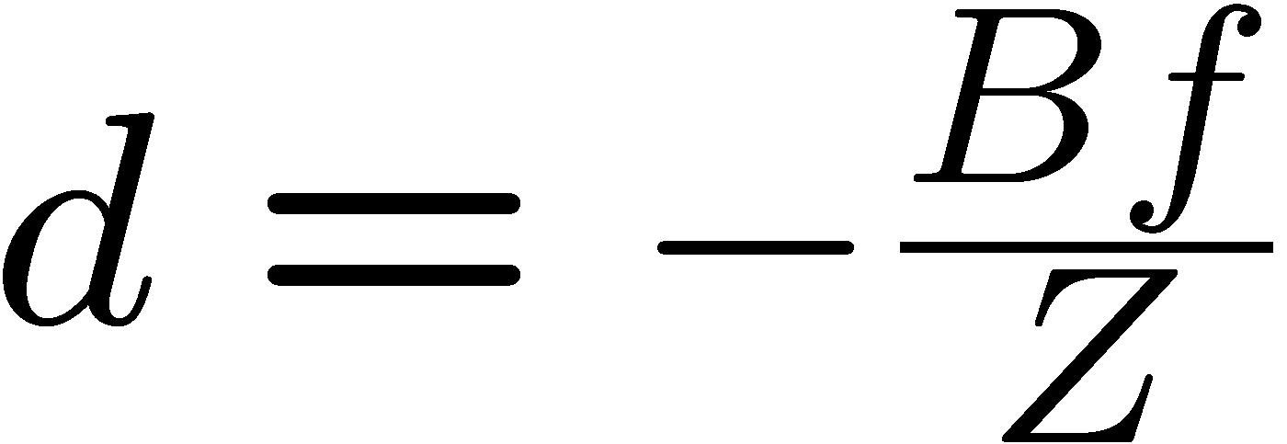



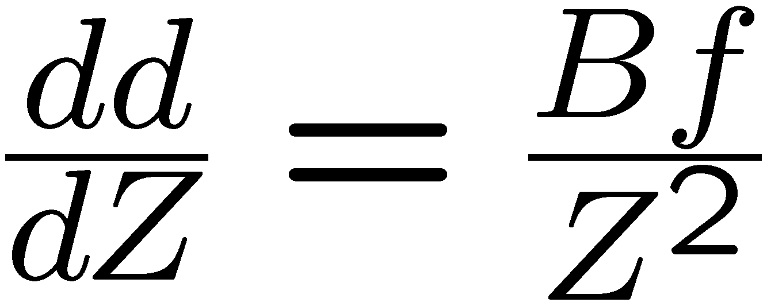
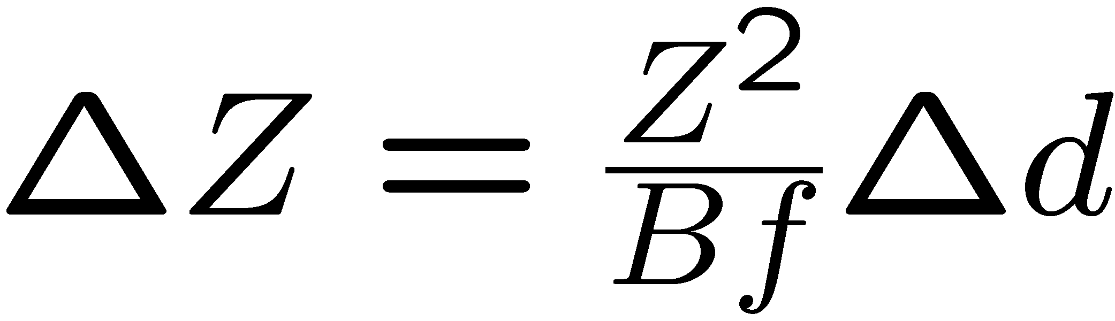
Standard stereo geometry

Slide 9
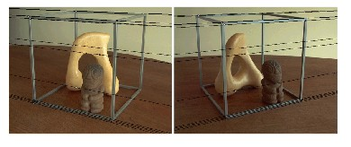
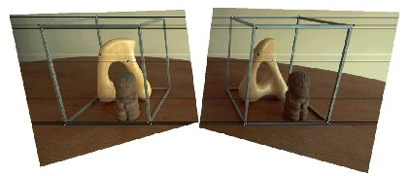
Actually searching for disparities.

Slide 10
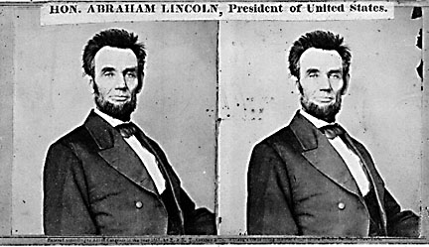
Basic stereo matching algorithm
If necessary, rectify the two stereo images to transform epipolar lines into scanlines
For each pixel x in the first image
Find corresponding epipolar scanline in the right image
Examine all pixels on the scanline and pick the best match x’
Compute disparity x-x’ and set depth(x) = fB/(x-x’)

Slide 11
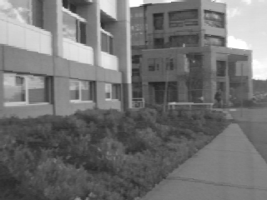
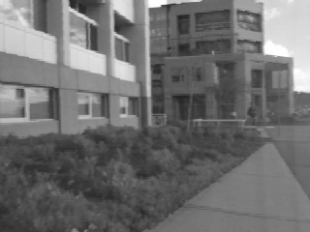
Correspondence search
Left
Right
scanline
Matching cost
disparity
Slide a window along the right scanline and compare contents of that window with the reference window in the left image
Matching cost: SSD or normalized correlation

Slide 12
Correspondence search
Left
Right
scanline
SSD

Slide 13
Correspondence search
Left
Right
scanline
Norm. corr

Slide 14
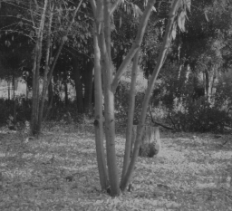
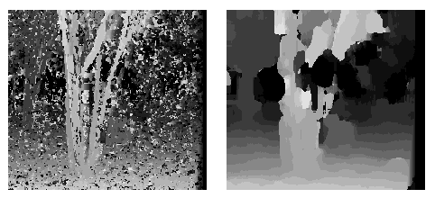
Effect of window size
W = 3
W = 20
Smaller window
+ More detail
More noise
Larger window
+ Smoother disparity maps
Less detail
Notes:
smaller window: more detail, more noise
bigger window: less noise, more detail

Slide 15

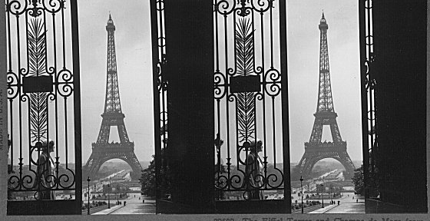
Failures of correspondence search
Textureless surfaces
Occlusions, repetition
Non-Lambertian surfaces, specularities

Slide 16
How can we improve window-based matching?
So far, matches are independent for each point
What constraints or priors can we add?

Slide 17
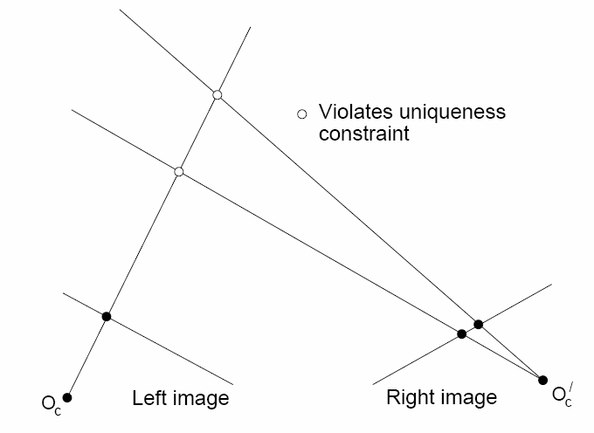
Stereo constraints/priors
Uniqueness
For any point in one image, there should be at most one matching point in the other image

Slide 18
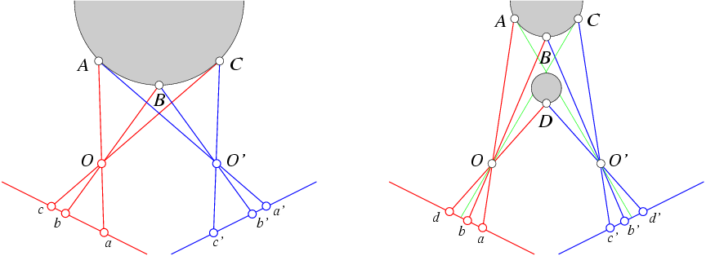
Stereo constraints/priors
Uniqueness
For any point in one image, there should be at most one matching point in the other image
Ordering
Corresponding points should be in the same order in both views

Slide 19
Stereo constraints/priors
Uniqueness
For any point in one image, there should be at most one matching point in the other image
Ordering
Corresponding points should be in the same order in both views
Ordering constraint doesn’t hold

Slide 20
Priors and constraints
Uniqueness
For any point in one image, there should be at most one matching point in the other image
Ordering
Corresponding points should be in the same order in both views
Smoothness
We expect disparity values to change slowly (for the most part)

Slide 21
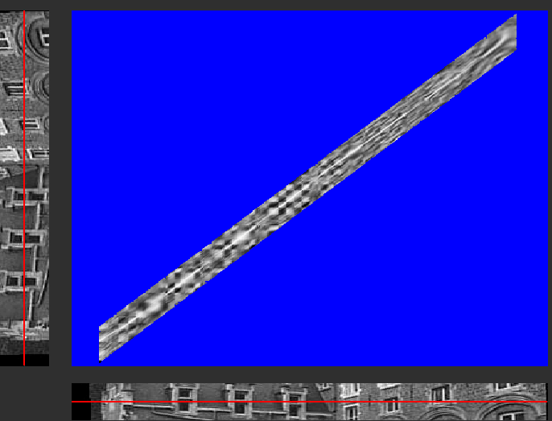
Stereo matching, the computer science approach.
Similarity measure
(SSD or NCC)
Constraints
epipolar
ordering
uniqueness
disparity limit
Trade-off
Matching cost (data)
Discontinuities (prior)
Optimal path
(dynamic programming )
Consider all paths that satisfy the constraints
pick best using dynamic programming

Slide 22
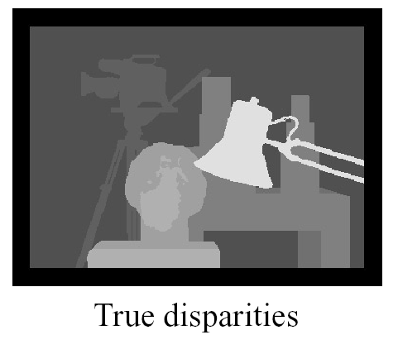
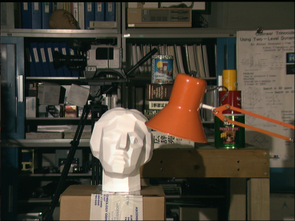
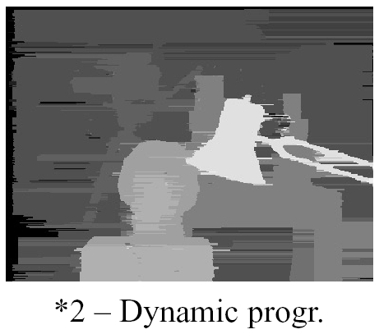
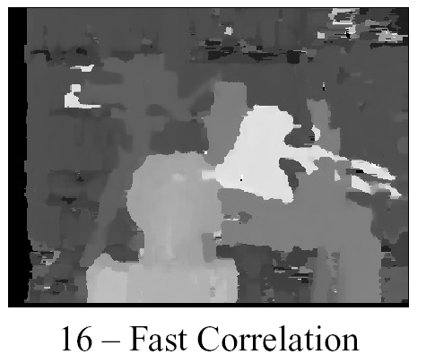

Slide 23
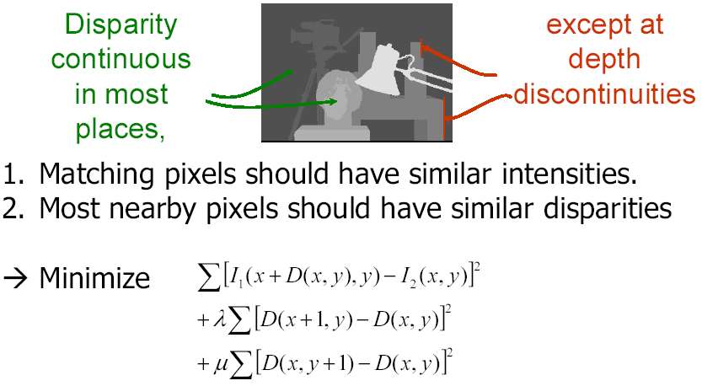
Energy minimization
(Slide from Pascal Fua)

Slide 24
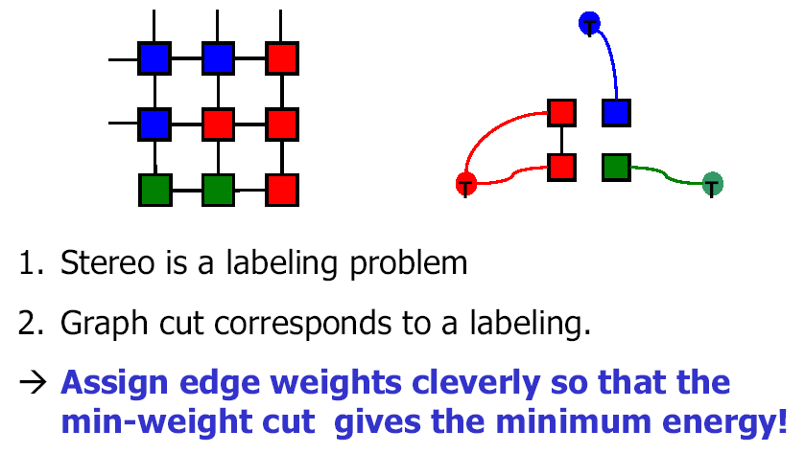
Graph Cut
(general formulation requires multi-way cut!)
(Slide from Pascal Fua)

Slide 25
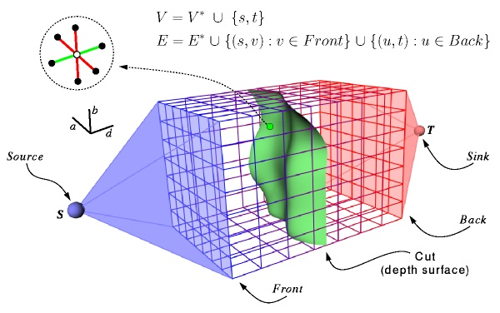
Simplified graph cut
(Roy and Cox ICCV‘98)

Slide 26
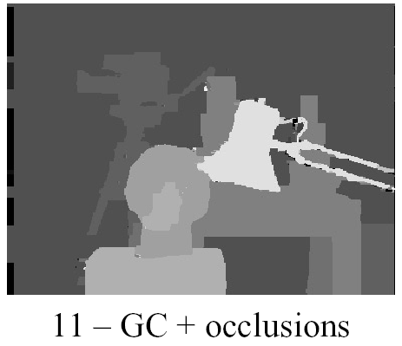
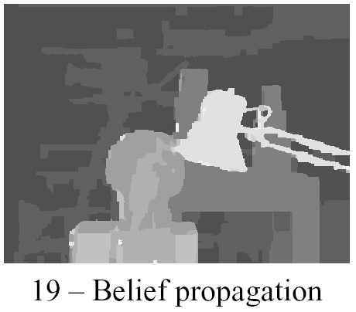

Slide 27
Pop quiz.
What are features of a scene that make it hard to get good stereo depth?

Slide 28
To every vision problem,
… there is an engineering solution.

Slide 30
Stereo Triangulation
I
J
Correspondence is hard!
Notes:
Here we see five frames from water flow sequence. Standard stereo method considers one pair of images. For each pixel in one image, we look for corresponding pixel in the other image. Then we intersect the line of sight to reconstruct the 3D surface. The key problem is computing correspondence. A simple way to do it is for each in the left image, we look for pixels on the same row in the right image and choose the pixel with most similar color. This can be done by minimizing the following error function.

Slide 31
Structured Light Triangulation
I
J
Correspondence becomes easier!

Slide 32
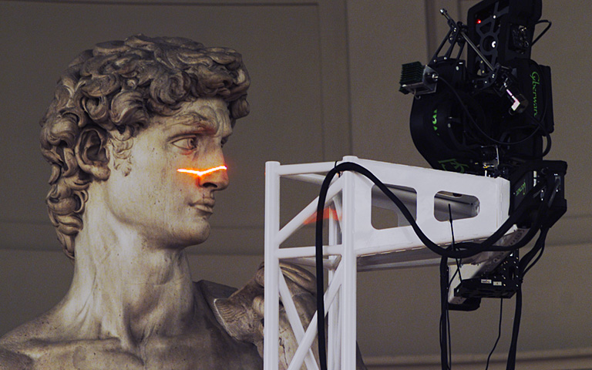
Example: Laser scanner
Digital Michelangelo Project
http://graphics.stanford.edu/projects/mich/

Slide 33
Binary Coding
Faster:
stripes in images.
Projected over time
Example:
3 binary-encoded patterns which allows the measuring surface to be divided in 8 sub-regions
Pattern 3
Pattern 2
Pattern 1

Slide 34
Binary Coding
Assign each stripe a unique illumination code over time [Posdamer 82]
Time
Space
Notes:
Just as an example, here’s a very simple code based on binary numbers. If you look at a single position in space (i.e., a single pixel), you see a certain on/off pattern over these four frames. This conveys a code that tells you which stripe you are looking at, which gives you a plane in space with which you can then triangulate to find depths.

Slide 35
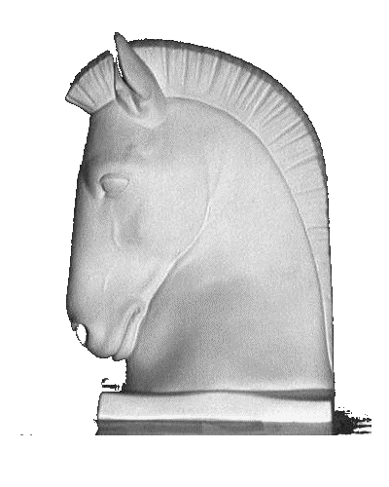
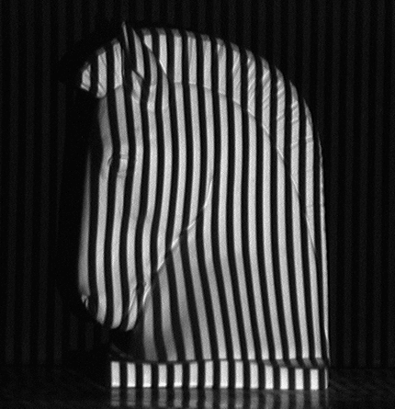
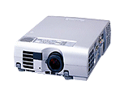
Binary Coding
Example: 7 binary patterns proposed by Posdamer & Altschuler
…
Projected over time
Pattern 3
Pattern 2
Pattern 1
Codeword of this píxel: 1010010 → identifies the corresponding pattern stripe

Slide 36
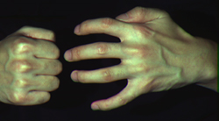
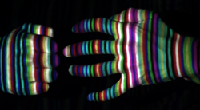
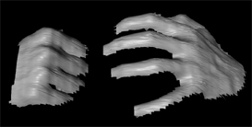
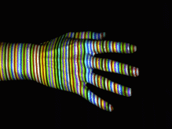
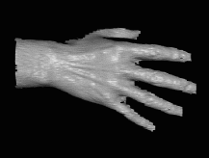
More complex patterns
Works despite complex appearances
Works in real-time and on dynamic scenes
Need very few images (one or two).
But needs a more complex correspondence algorithm
Zhang et al

Slide 37
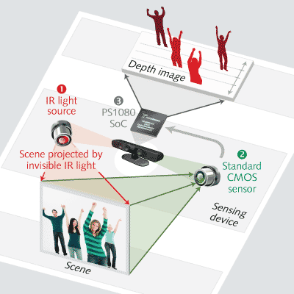
Kinect
Another structure light method
Use dots rather than strips
http://www.laserfocusworld.com/articles/2011/01/lasers-bring-gesture-recognition-to-the-home.html

Slide 38
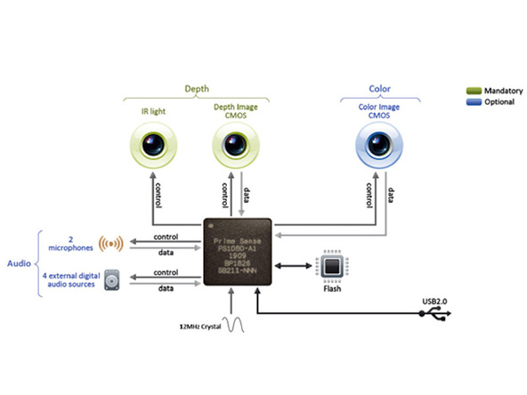


Kinect Hardware

Slide 39


See the IR-dots emitted by KINECT
http://www.youtube.com/watch?v=dTKlNGSH9Po&feature=related

